Slide 1

FAKE JOB POSTING DETECTION
Using Machine Learning & Natural Language Processing
STUDENT
Anjali Pandey
DEPARTMENT
Bachelor of Computer Applications (BCA)
COLLEGE
Starex University
GUIDE
Priyanka Pal
ACADEMIC YEAR
2024-2027
Fake Job Posting Detection Using Machine Learning
1
Notes:
Greet the panel and introduce the project by name. State that it detects fraudulent job postings using Machine Learning and NLP, and that the final model deployed is a Linear SVM. Mention your name and department briefly before moving on.

Slide 2


Introduction
What Is Recruitment Fraud?
Project Overview
Fake job advertisements posted to deceive job seekers
Used to collect money, personal data, or free labor
Widespread on online job portals and social media
ML + NLP system that classifies job posts as Genuine or Fraudulent
Cleans data, engineers text features, and vectorizes with TF-IDF
Compares multiple models; deploys the best performer
Delivered as an interactive Streamlit web application
Generates AI insights and downloadable PDF reports
Why Detection Matters
Protects job seekers from financial and identity fraud
Builds trust and credibility of job portals
Manual screening cannot scale with posting volume
Fake Job Posting Detection Using Machine Learning
2
Notes:
Explain recruitment fraud in simple terms — fake job ads that trick applicants into paying fees or sharing personal data. Emphasize why this matters at scale on job portals, then summarize the project as an ML+NLP pipeline ending in a deployed Streamlit app.

Slide 3



Problem Statement
Existing Problems
Need For System
Objectives
Fraudulent posts mimic genuine ones closely
Manual review is slow and error-prone
Victims lose money and personal data
Automated, scalable screening is required
Consistent, unbiased decision-making
Real-time protection for job seekers
Build an accurate fraud classification model
Apply NLP to analyse posting text
Deploy as an easy-to-use web application
Bottom line: manual moderation cannot keep pace with fraud volume — an ML-driven, NLP-based classifier is needed to flag suspicious postings automatically and reliably.
Fake Job Posting Detection Using Machine Learning
3
Notes:
Walk through why manual moderation fails at scale, then state the objectives: build an accurate classifier, apply NLP to the text, and ship it as a usable web application. Keep this slide brief — it's the motivation, not the detail.

Slide 4


Dataset
17,880
17,014
866
Total Records
Genuine Postings
Fraudulent Postings
Dataset Details
Key Characteristic
Source: Kaggle — “Fake Job Posting Prediction” dataset
Target variable: Fraudulent (binary — Genuine vs Fraudulent)
Features: title, description, requirements, company profile, and more
Highly imbalanced: fraudulent posts are the minority class
Class Imbalance
Only ~4.8% of postings are fraudulent, requiring careful handling during preprocessing and evaluation to avoid a biased model.
Fake Job Posting Detection Using Machine Learning
4
Notes:
Describe the dataset briefly: sourced from Kaggle, 17,880 total postings, with 17,014 genuine and 866 fraudulent. Point out the class imbalance and explain that it's an important factor for model evaluation later.

Slide 5

Methodology
1
2
3
4
EDA
Data
Collection
Data
Cleaning
Text
Preprocessing
8
7
6
5
Deployment
Model
Evaluation
Model
Training
TF-IDF
EDA
Model
Evaluation
Deployment
Fake Job Posting Detection Using Machine Learning
5
Notes:
Walk through the methodology pipeline left to right: data collection, cleaning, EDA, text preprocessing, TF-IDF, model training, evaluation, and deployment. Keep to one sentence per stage.

Slide 6
Methodology
Data Prep
Modeling
Data
Collection
Raw postings are collected and cleaned — handling missing values, duplicates, and noisy text.
Multiple classifiers are trained, tuned, and evaluated before the best is deployed.
Analysis & NLP
Evaluation & Deployment
EDA reveals class patterns; text is tokenized, lemmatized, and vectorized with TF-IDF.
Trained models are compared using F1-score and ROC-AUC, with the top performer selected for deployment.
Fake Job Posting Detection Using Machine Learning
5
Notes:
Walk through the methodology pipeline left to right: data collection, cleaning, EDA, text preprocessing, TF-IDF, model training, evaluation, and deployment. Keep to one sentence per stage.

Slide 7






Natural Language Processing
1
2
3
4
5
Tokenization
Stopword Removal
Lemmatization
TF-IDF
Feature Extraction
Splitting raw posting text into individual words or tokens for analysis.
Removing common, low-signal words (e.g. “the”, “and”) to reduce noise.
Reducing words to their base/dictionary form for consistent matching.
Weighting words by importance across the corpus of job postings.
Converting cleaned text into numeric vectors the model can learn from.
Fake Job Posting Detection Using Machine Learning
6
Notes:
Explain each NLP step briefly in order: tokenization breaks text into words, stopword removal strips noise, lemmatization normalizes word forms, TF-IDF weights importance, and the result feeds feature extraction for the model.

Slide 8
Machine Learning Models
Naïve Bayes
Random Forest
Logistic Regression
Linear SVM
Ensemble of decision trees capturing non-linear feature interactions.
Simple, interpretable linear baseline for binary classification.
Finds the optimal margin between genuine and fraudulent postings.
It predicts class using word frequencies via Bayes' theorem, assuming feature independence.
SELECTED MODEL
Linear SVM was selected as the final deployed model — it delivered the strongest overall balance of accuracy and generalization on the held-out test data.
Fake Job Posting Detection Using Machine Learning
7
Notes:
Introduce the three models compared: Logistic Regression as a baseline, Random Forest as an ensemble method, and Linear SVM. State clearly that Linear SVM was selected as the final model because it performed best overall.

Slide 9

Model Evaluation
Note: metrics reflect performance on the held-out test split; class imbalance means precision/recall on the fraudulent class matter as much as overall accuracy.
Fake Job Posting Detection Using Machine Learning
8
Notes:
Present the evaluation metrics for the Linear SVM model on the chart. Mention that precision and recall matter especially due to class imbalance. Note that the confusion matrix, classification report, and ROC curve placeholders should be filled with your actual results before the viva.

Slide 10
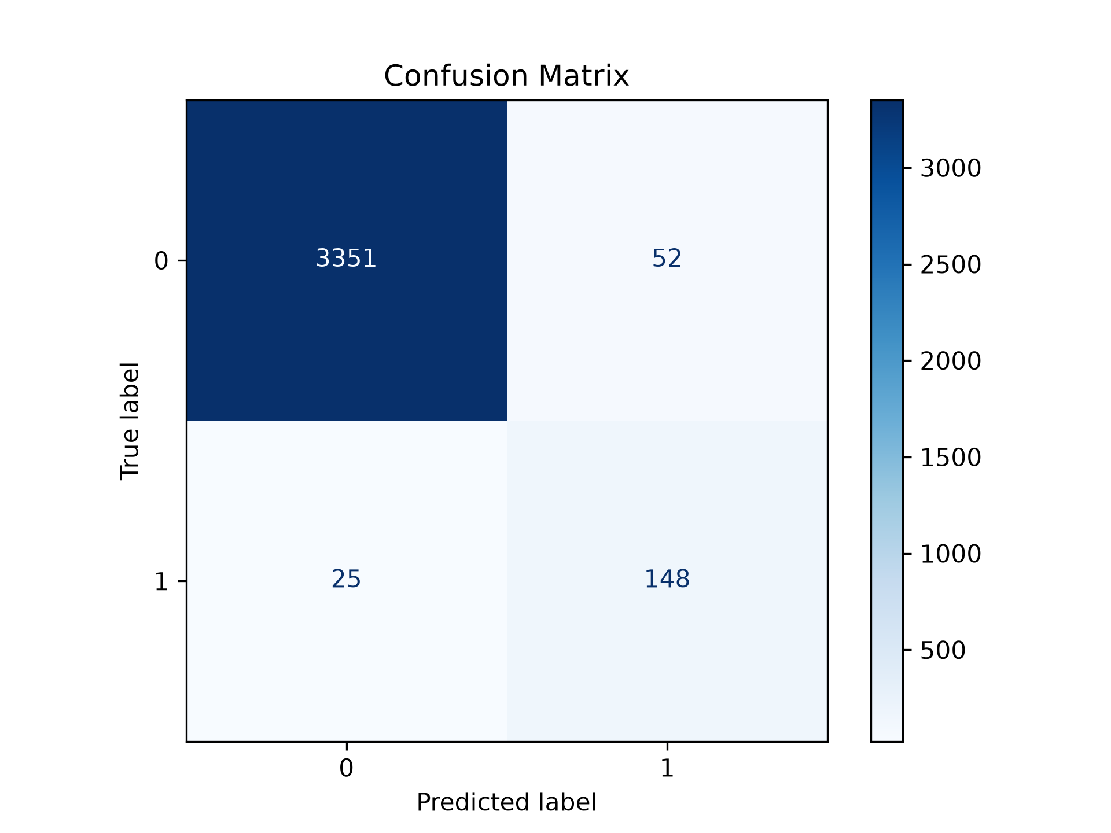
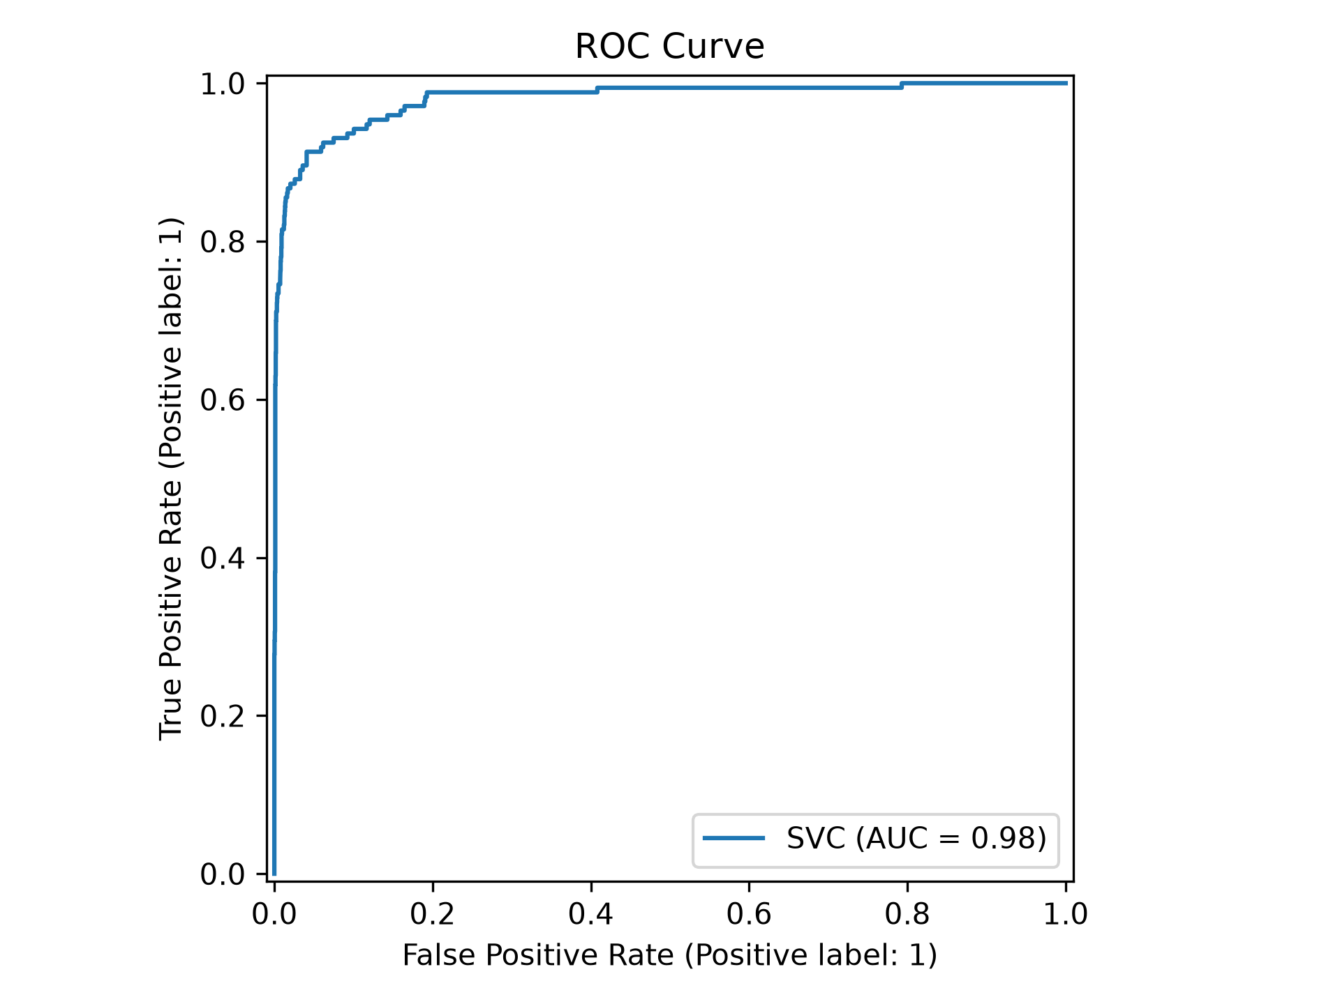
Model Evaluation
Classification Report
precision recall f1-score support
0 0.99 0.98 0.99 3403
1 0.74 0.86 0.79 173
accuracy 0.98 3576
macro avg 0.87 0.92 0.89 3576
weighted avg 0.98 0.98 0.98 3576
Confusion Matrix
ROC Curve
Note: metrics reflect performance on the held-out test split; class imbalance means precision/recall on the fraudulent class matter as much as overall accuracy.
Fake Job Posting Detection Using Machine Learning
8
Notes:
Present the evaluation metrics for the Linear SVM model on the chart. Mention that precision and recall matter especially due to class imbalance. Note that the confusion matrix, classification report, and ROC curve placeholders should be filled with your actual results before the viva.

Slide 11







System Architecture
User
Streamlit UI
Input
Processing
NLP
Preprocessing
TF-IDF
Vectorizer
Linear SVM
Model
Prediction
AI Insights
PDF Report
Front End
Processing
Inference
Output
The user submits a job posting through the Streamlit interface.
Text is cleaned, tokenized, and transformed into TF-IDF vectors.
The Linear SVM model classifies the post and produces AI insights.
Results are shown in-app and can be exported as a PDF report.
Fake Job Posting Detection Using Machine Learning
9
Notes:
Walk through the system architecture flow: the user submits a posting through the Streamlit UI, it's processed and passed through NLP preprocessing and the TF-IDF vectorizer, then classified by the Linear SVM model, producing a prediction, AI insights, and a PDF report.

Slide 12

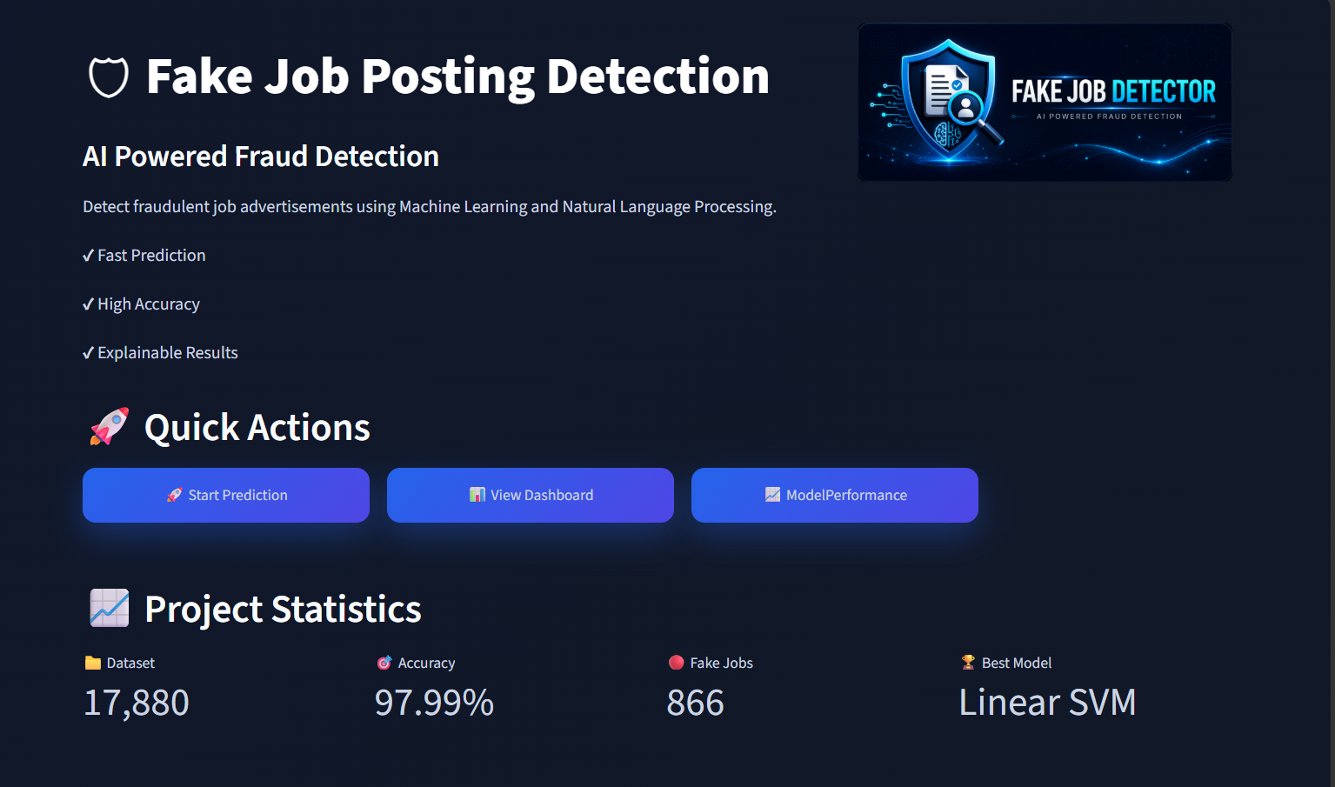
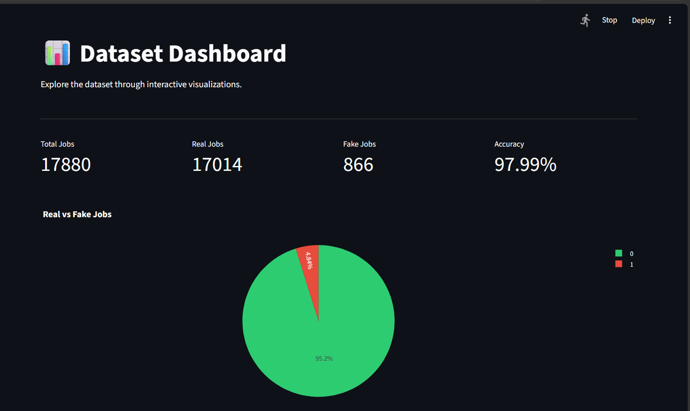
Application Screenshots
[Insert Home Page Screenshot]
[Insert Prediction Page Screenshot]
Home Page
Dashboard
Fake Job Posting Detection Using Machine Learning
10
Notes:
Show the actual application screenshots here — replace each placeholder with a screenshot of the Home Page, Dashboard, Prediction Page, AI Insights, Model Performance, and PDF Report before your viva.

Slide 13
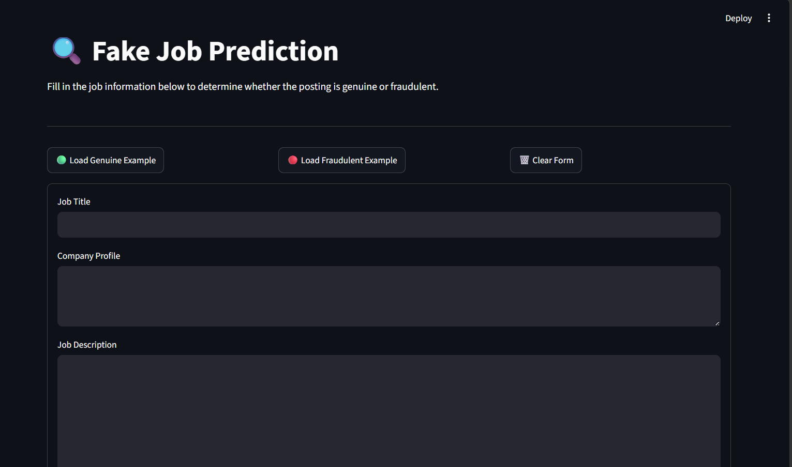
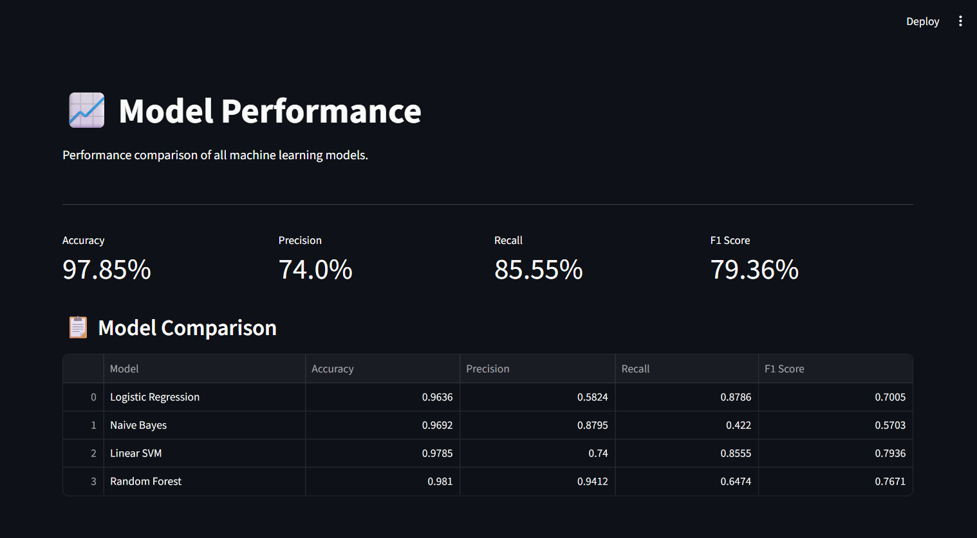
Application Screenshots
[Insert Home Page Screenshot]
[Insert Prediction Page Screenshot]
Predict
Model Performance
Fake Job Posting Detection Using Machine Learning
10
Notes:
Show the actual application screenshots here — replace each placeholder with a screenshot of the Home Page, Dashboard, Prediction Page, AI Insights, Model Performance, and PDF Report before your viva.

Slide 14
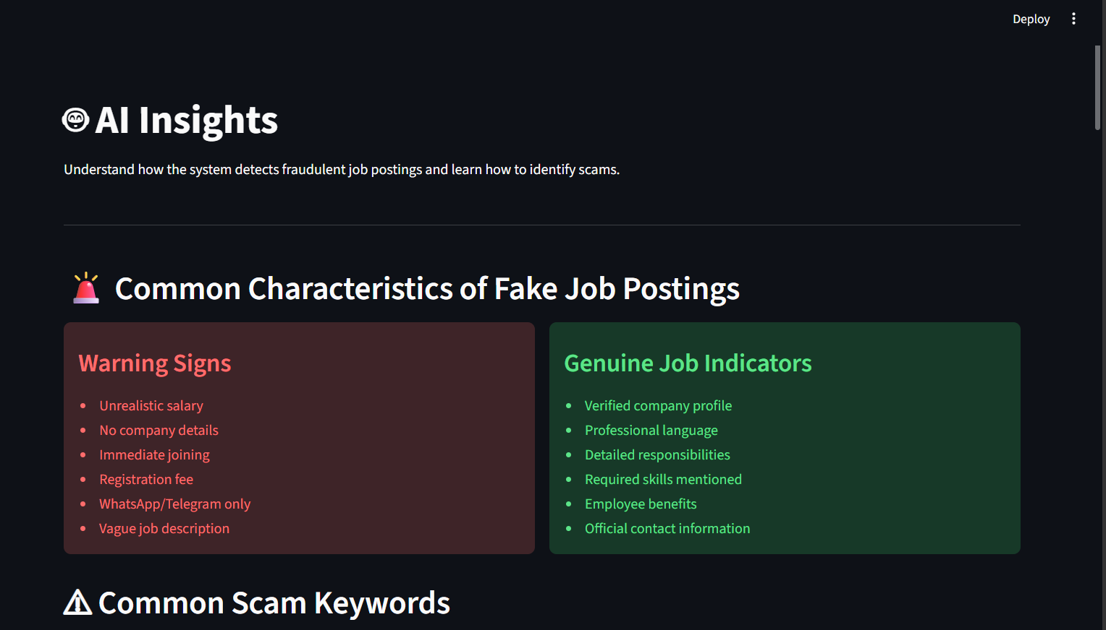
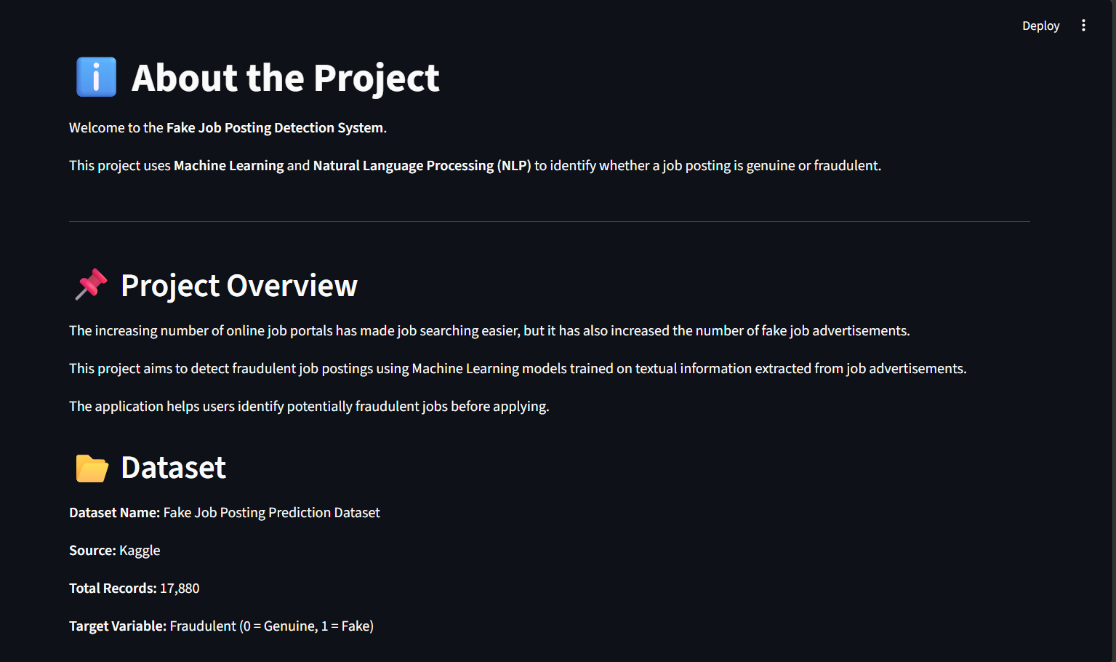
Application Screenshots
[Insert Home Page Screenshot]
[Insert Prediction Page Screenshot]
AI Insight
About the Project
Fake Job Posting Detection Using Machine Learning
10
Notes:
Show the actual application screenshots here — replace each placeholder with a screenshot of the Home Page, Dashboard, Prediction Page, AI Insights, Model Performance, and PDF Report before your viva.

Slide 15



Key Features
Fraud Detection
NLP-Based Analysis
Interactive Dashboard
AI Insights
Classifies postings as Genuine or Fraudulent in real time.
Understands posting text through tokenization & TF-IDF.
Visual exploration of dataset trends and statistics.
Explains why a posting was flagged, with keyword signals.
PDF Report Generation
Confidence Score
User-Friendly Interface
Downloadable report summarizing each prediction.
Probability score indicating prediction certainty.
Clean Streamlit UI accessible to non-technical users.
Fake Job Posting Detection Using Machine Learning
11
Notes:
Highlight the key features of the deployed application: fraud detection, NLP-based analysis, the interactive dashboard, AI insights, PDF report generation, confidence scores, and the user-friendly interface.

Slide 16



Future Scope
Deep Learning Models
Transformer NLP (BERT)
Real-Time API Integration
Explore LSTM / neural architectures for richer text understanding.
Adopt contextual embeddings to improve classification nuance.
Let job portals screen postings instantly via a live API.
Cloud Deployment
Mobile Application
Explainable AI Enhancements
Host the model for scalable, always-on public access.
Bring fraud detection to Android and iOS for on-the-go checks.
Add SHAP/LIME-style explanations for full transparency.
Fake Job Posting Detection Using Machine Learning
12
Notes:
Discuss future improvements briefly: deep learning models, transformer-based NLP like BERT, real-time API integration, cloud deployment, a mobile app, and explainable AI enhancements. Frame these as natural next steps, not current gaps.

Slide 17

Conclusion
Project Achievements
Learning Outcomes
Built an end-to-end ML/NLP pipeline that classifies job postings with strong accuracy and deployed it as a working web app.
Hands-on experience with text preprocessing, TF-IDF, model comparison, and full-stack ML deployment with Streamlit.
Business Impact
Real-World Applications
Reduces exposure of job seekers to recruitment fraud and strengthens trust in job portals.
Adaptable to job boards, HR platforms, and recruitment agencies for automated fraud screening.
Fake Job Posting Detection Using Machine Learning
13
Notes:
Summarize what the project achieved, what you personally learned, and why it matters practically — protecting job seekers and building trust in recruitment platforms. Keep this concise and confident.

Slide 18

Thank You
Fake Job Posting Detection Using Machine Learning
14
Notes:
Thank the panel for their time and invite questions. Pause here and be ready to discuss any slide in more depth if asked.

